Slide 1
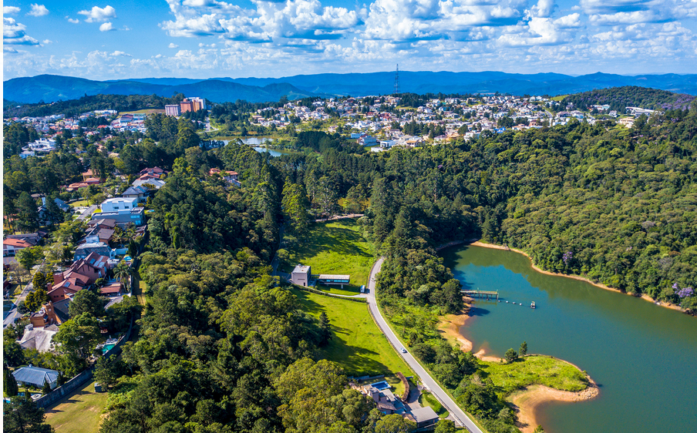
ALDEIA DA SERRA REAL ESTATE
web scraping

Slide 2
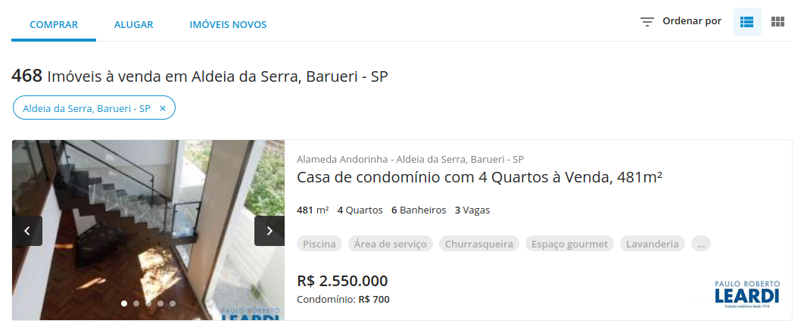
8
1
2
3
4
5
6
7

